Slide 1
Chapter 7:
Advanced SQL -JOINS
Modern Database Management
10th Edition
Jeffrey A. Hoffer, V. Ramesh,
Heikki Topi
© 2011 Pearson Education, Inc. Publishing as Prentice Hall

Slide 2
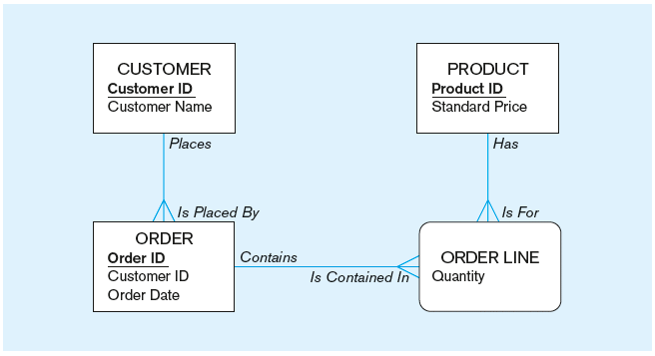
The following slides create tables for this enterprise data model
(from Chapter 1, Figure 1-3)

Slide 3
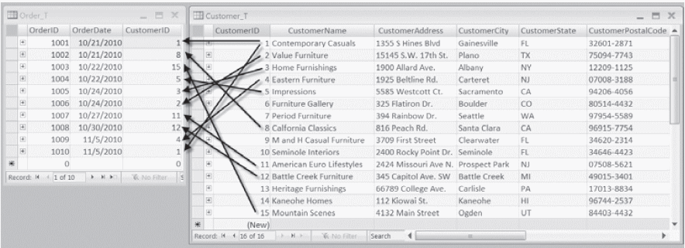
Figure 7-1 Pine Valley Furniture Company Customer_T and Order_T tables with pointers from customers to their orders
These tables are used in queries that follow
Notes:
Example of 1:M relationship.
Customer ID 1 has 2 orders
CustID 2 has only 1 order
Cust ID 3 only 1 order, 7 no order
Overall, some customers have not orders, some customers have only one order, etc.

Slide 4
Books version: Three Types of JOIN
Natural JOIN – not supported by many vendors, can be achieved via INNER JOIN
Equi JOIN - not need to differentiate joins based on equality. Other operators such as >=, <=, <> between etc.
UNION JOIN - commonly referred to as FULL JOIN

Slide 5
Practical Version: Four Types of JOINS
INNER JOIN
OUTER JOIN
  LEFT OUTER JOIN
  RIGHT OUTER JOIN
FULL JOIN

Slide 6
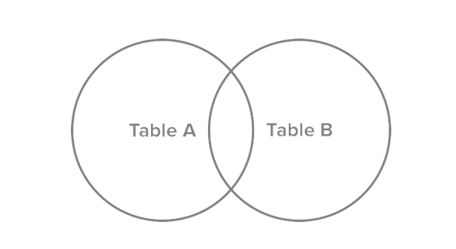
JOINS visualization

Slide 7
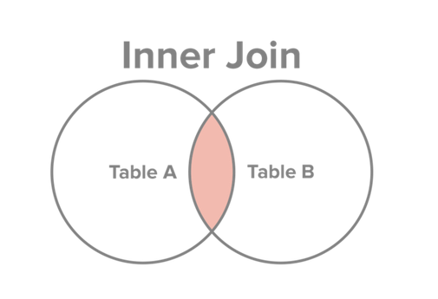
INNER JOIN
Select all records from Table A and Table B, where the join condition is met.
http://www.sql-join.com/sql-join-types/

Slide 8
INNER JOIN SQL
SELECT c. CustomerID, c.CustomerName, o.OrderID
FROM Customer_T c INNER JOIN ORDER_T AS o ON c.CustomerID = o.CustomerID
Key word INNER is optional:
SELECT c. CustomerID, c.CustomerName, o.OrderID
FROM Customer_T c JOIN ORDER_T AS o ON c.CustomerID = o.CustomerID
Notes:
This query returns only customers that have orders,
If a customer doesn’t have orders it doesn’t show up

Slide 9
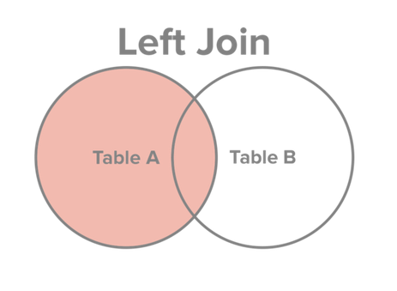
JOINS: LEFT OUTER JOIN
Select all records from Table A, along with records from Table B for which the join condition is met (if at all).
http://www.sql-join.com/sql-join-types/

Slide 10
LEFT OUTER JOIN SQL
SELECT c. CustomerID, c.CustomerName, o.OrderID
FROM Customer_T c LEFT OUTER JOIN ORDER_T AS o ON c.CustomerID = o.CustomerID
Key word OUTER is optional:
SELECT c. CustomerID, c.CustomerName, o.OrderID
FROM Customer_T c LEFT JOIN ORDER_T AS o ON c.CustomerID = o.CustomerID
Notes:
This query returns only customers that have orders,
If a customer doesn’t have orders it doesn’t show up

Slide 11
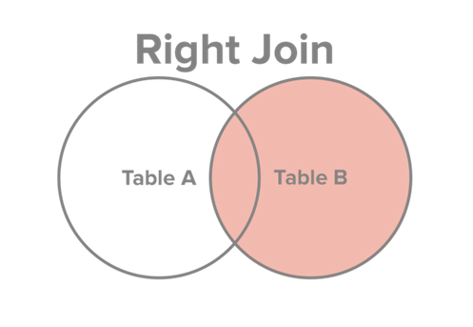
JOINS: RIGHT OUTER JOIN
Select all records from Table B, along with records from Table A for which the join condition is met (if at all).
http://www.sql-join.com/sql-join-types/

Slide 12
RIGHT OUTER JOIN SQL
SELECT c. CustomerID, c.CustomerName, o.OrderID
FROM Order_T o RIGHT OUTER JOIN Customer_T c ON c.CustomerID = o.CustomerID
Key word OUTER is optional:
SELECT c. CustomerID, c.CustomerName, o.OrderID
FROM Order_T o RIGHT JOIN Customer_T c ON c.CustomerID = o.CustomerID
Notes:
This query returns only customers that have orders,
If a customer doesn’t have orders it doesn’t show up

Slide 13
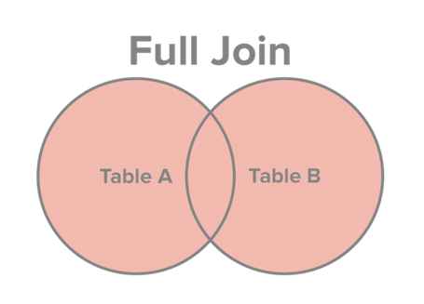
JOINS: FULL JOIN
Select all records from Table A and Table B, regardless of whether the join condition is met or not.
http://www.sql-join.com/sql-join-types/

Slide 14
FULL JOIN SQL
SELECT c. CustomerID, c.CustomerName, o.OrderID
FROM Customer_T c FULL JOIN ORDER_T AS o ON c.CustomerID = o.CustomerID
Notes:
This query returns only ORDERS orders,
If a customer doesn’t have orders it doesn’t show up

Slide 15
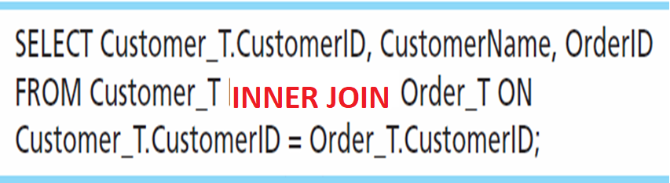
Inner Join Example
For each customer who placed an order, what is the customer’s name and order number?
Join involves multiple tables in FROM clause
ON clause performs the equality check for common columns of the two tables
Note: from Fig. 7-1, you see that only 10 Customers have links with orders
➔ Only 10 rows will be returned from this INNER join
Notes:
In this example will only return rows where customers have orders. Flip to the data sheet and ask questions about each row

Slide 16
Different JOIN syntax
SELECT Custsomer_T.CustomerID, CustomomerName, OrderID
FROM Customer_T INNER JOIN Order_T ON Customer_T.CustomerID = Order_T.CustomerID
SELECT Custsomer_T.CustomerID, CustomomerName, OrderID
FROM Customer_T, Order_T
WHERE Customer_T.CustomerID = Order_T.CustomerID
Notes:
Implicit and explicit JOIN notations
Implicit JOIN notation -> no longer considered best practice!
Which syntax is better, the one on top, the other is prior SQL 92 standards.

Slide 17
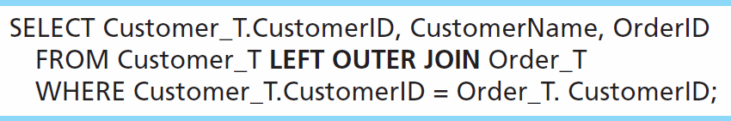
Outer Join Example
List the customer name, ID number, and order number for all customers. Include customer information even for customers that do have an order.
LEFT OUTER JOIN clause causes customer data to appear even if there is no corresponding order data
Unlike INNER join, this will include customer rows with no matching order rows

Slide 18
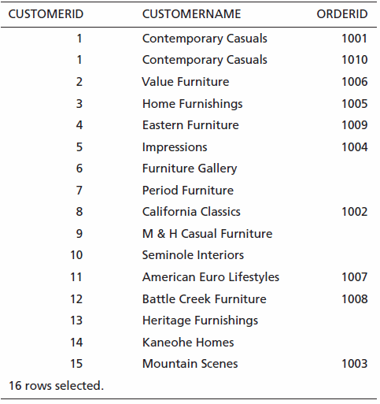
Results
Unlike INNER join, this will include customer rows with no matching order rows
Notes:
What happens when records content match the other table , displays NULL, empty

Slide 19
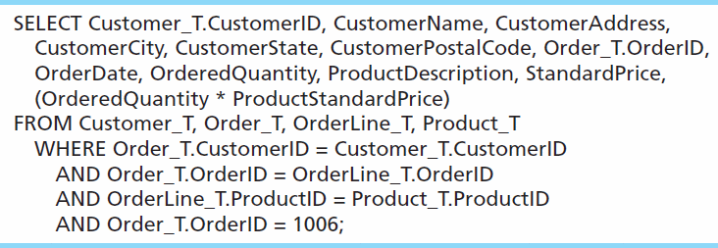
Multiple Table Join Example
Assemble all information necessary to create an invoice for order number 1006
Four tables involved in this join
Each pair of tables requires an equality-check condition in the WHERE clause, matching primary keys against foreign keys
Notes:
Example with old style

Slide 20
SELECT c.CustomerID, c.CustomerName, c.CustomerAddress, c.CustomerCity, c.CustomerState, c.CustomerPostalCode, o.OrderID, o.OrderDate, ol.OrderedQuantity, p.ProductDescription, p.StandardPrice, ( ol.OrderedQuantity*p.ProductStandardPrice)
FROM Customer_T c JOIN Order_T o ON c.CustomerID = o.CustomerID
JOIN OrderLine_T ol ON o.OrderID = ol.OrderID
JOIN Product_T p ON ol.ProductID = p.ProductID
WHERE o.OrderID = 1006

Slide 21
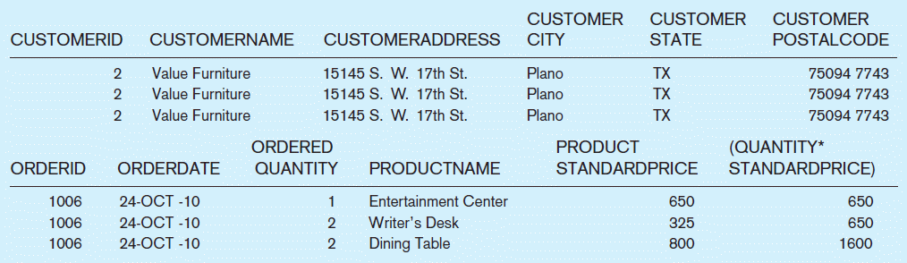
Figure 7-4 Results from a four-table join (edited for readability)
From CUSTOMER_T table
From ORDER_T table
From PRODUCT_T table

Slide 22
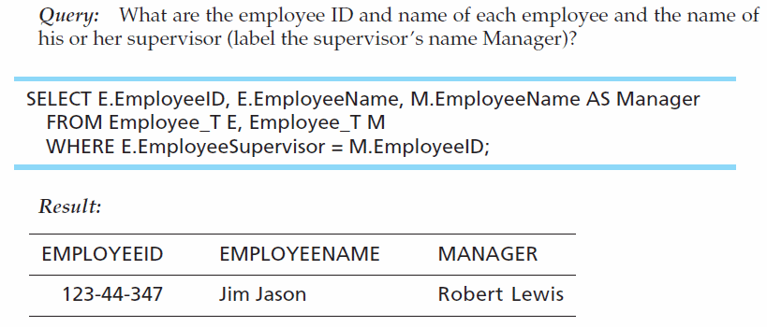
Self-Join Example
The same table is used on both sides of the join; distinguished using table aliases
Self-joins are usually used on tables with unary relationships
Notes:
Use of alias

Slide 23
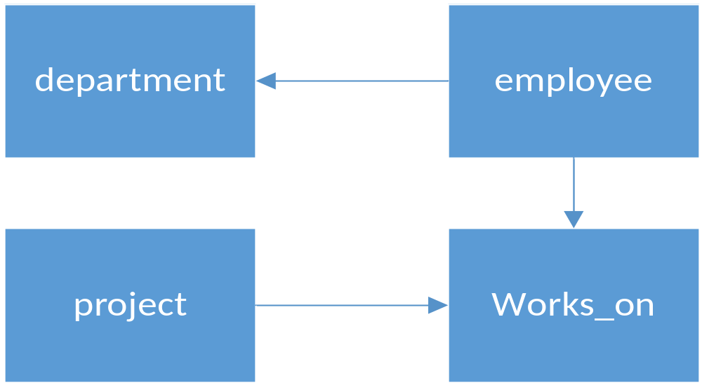
Exercise
Notes:
SELECT e.emp_fname, e.emp_lname, w.job
FROM employee e left join works_on w on e.emp_no = w.emp_no

Slide 24
Problem 1
Write a SQL query to return employee names (first and last), project names and budget. Only show employees working on projects with budget >$140,000
Notes:
select e.emp_fname, e.emp_lname, p.project_name, p.budget
from employee e JOIN works_on w on e.emp_no = w.emp_no
JOIN project p on w.project_no = p.project_no
where budget>140000

Slide 25
Problem 2
Write a SQL query to return employee names (first and last), project names and budget. Show all employees even if they didn’t work on any project.
Modify the same query to only show employees in Finance department
Notes:
select e.emp_fname, e.emp_lname, p.project_name, p.budget
from employee e LEFT JOIN works_on w on e.emp_no = w.emp_no
LEFT JOIN project p on w.project_no = p.project_no
select e.emp_fname, e.emp_lname, p.project_name, p.budget
from employee e LEFT JOIN works_on w on e.emp_no = w.emp_no
LEFT JOIN project p on w.project_no = p.project_no
where dept_no ='D2'

Slide 26
Problem 3
Write a SQL query to return employee names (first and last), and total budget for all projects they worked on. Show only employees who worked on a project(s)
Modify the query to show only employees where the total budget is less than $110,000
Notes:
select e.emp_fname, e.emp_lname, sum( p.budget) total_budget
from employee e JOIN works_on w on e.emp_no = w.emp_no
JOIN project p on w.project_no = p.project_no
group by e.emp_fname, e.emp_lname
select e.emp_fname, e.emp_lname, sum( p.budget) total_budget
from employee e JOIN works_on w on e.emp_no = w.emp_no
JOIN project p on w.project_no = p.project_no
group by e.emp_fname, e.emp_lname
having sum( p.budget)<110000

Slide 27
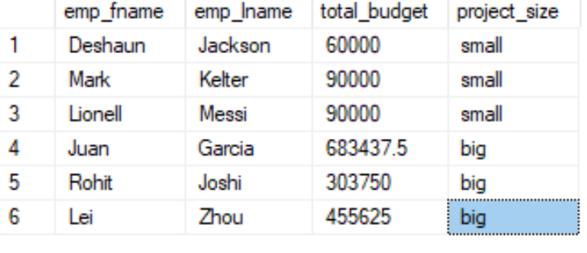
Problem 4
Modify problem 3 to include both employees with total budget less than $110,00 and employees with total budget greater than $300,000. Create a column project size to denote < $110,00 small and > 300k big.
Notes:
select e.emp_fname, e.emp_lname, sum( p.budget) total_budget, 'small' as project_size
from employee e JOIN works_on w on e.emp_no = w.emp_no
JOIN project p on w.project_no = p.project_no
group by e.emp_fname, e.emp_lname
having sum( p.budget)<110000
union all
select e.emp_fname, e.emp_lname, sum( p.budget) total_budget, 'big'
from employee e JOIN works_on w on e.emp_no = w.emp_no
JOIN project p on w.project_no = p.project_no
group by e.emp_fname, e.emp_lname
having sum( p.budget)>300000

